Slide 1
Soft Pro Launch
With Business & Individual of
User & Store Modules
(All Stores, Shops in mall, nearby shops, wholesale, Grocery, Restaurants Cart, Checkout, notifications and my orders)

Slide 2
Individual (Mobile App)

Slide 3
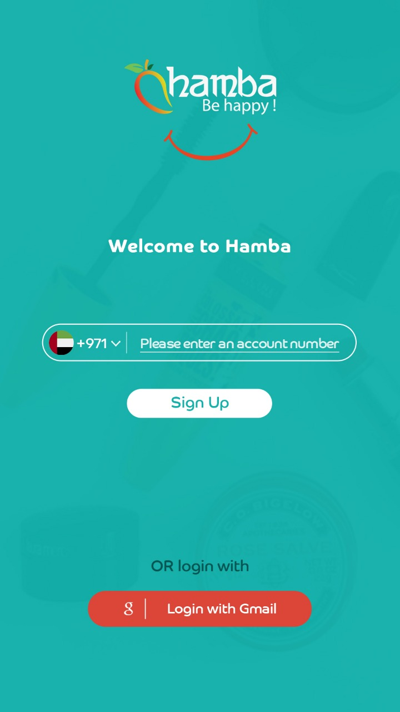
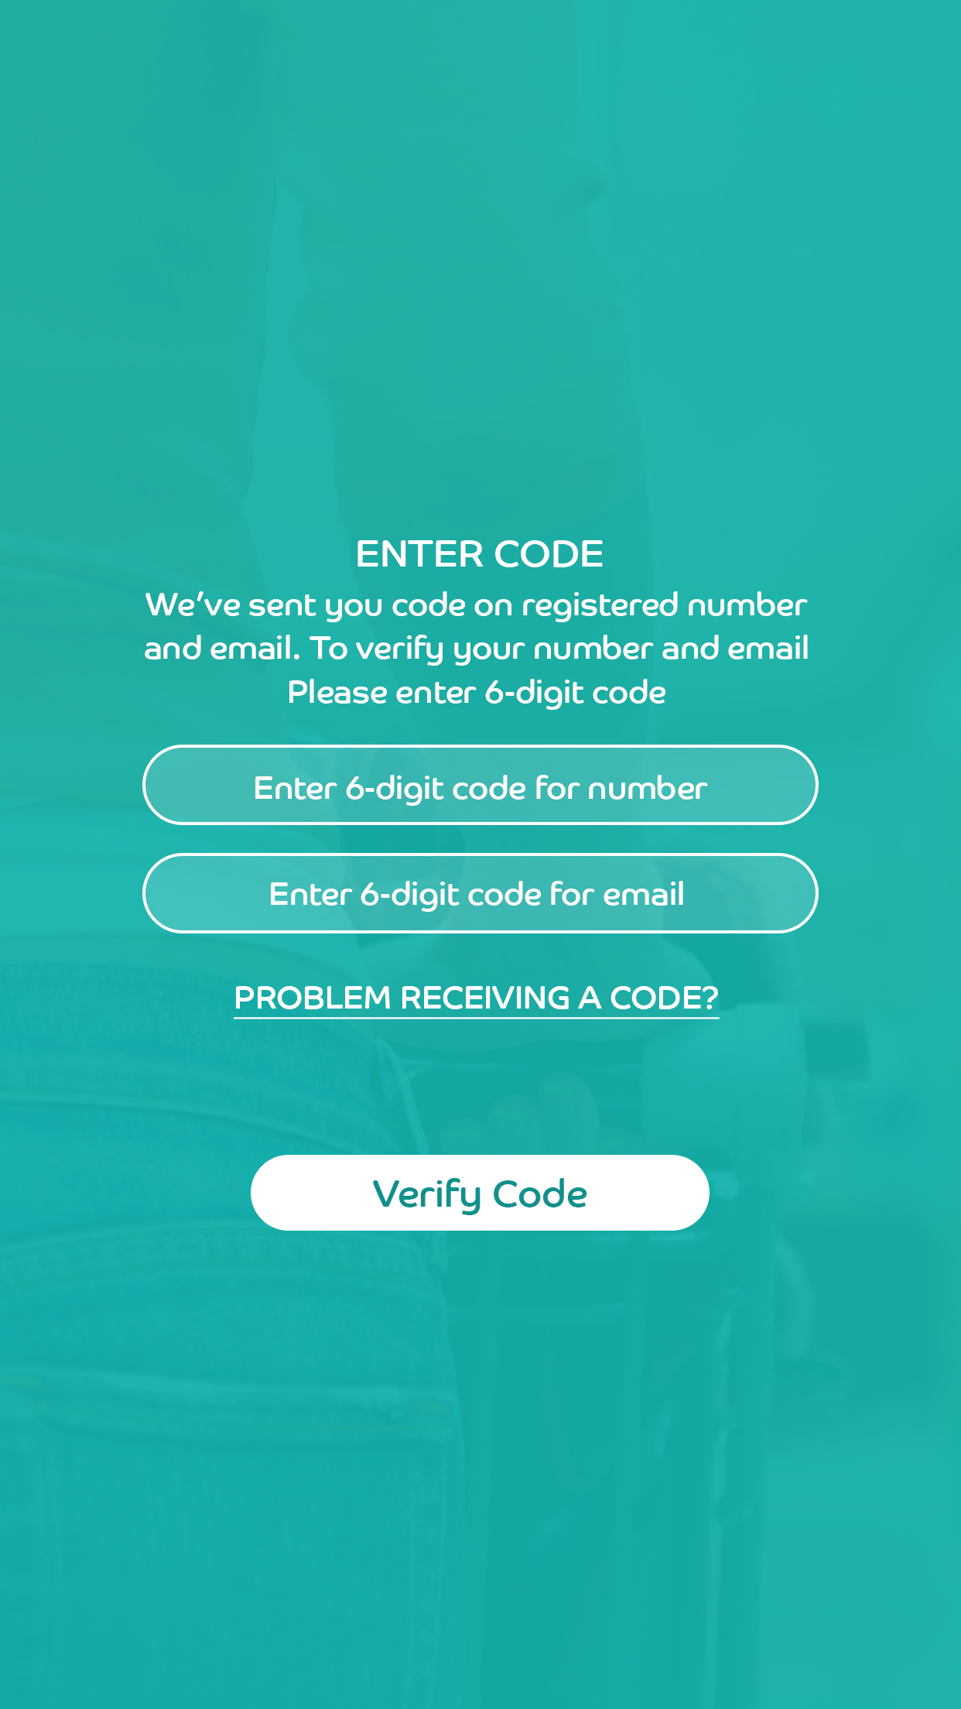
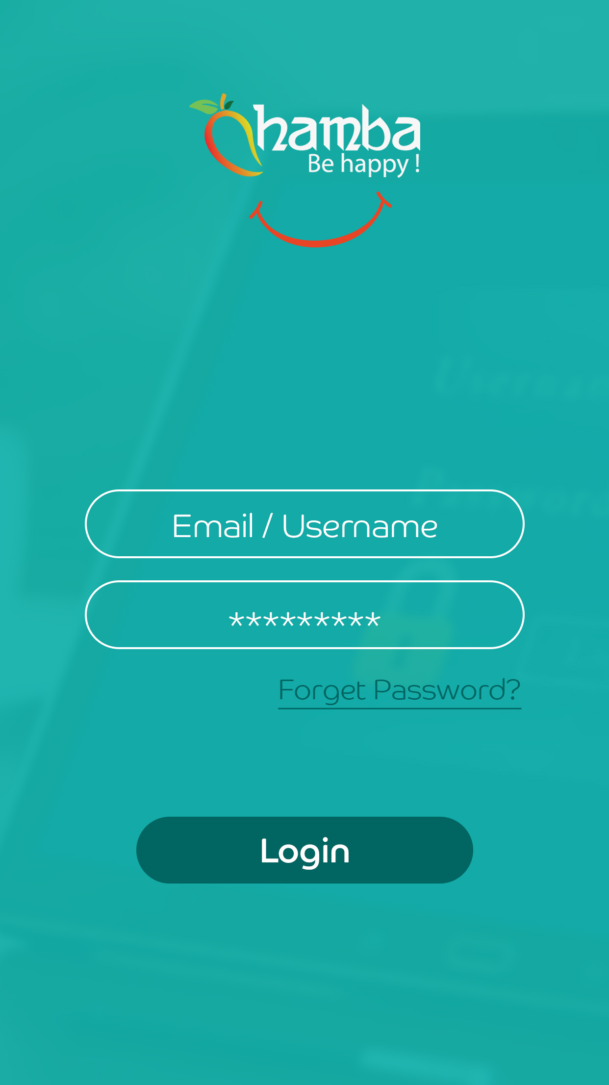
User module

Slide 4
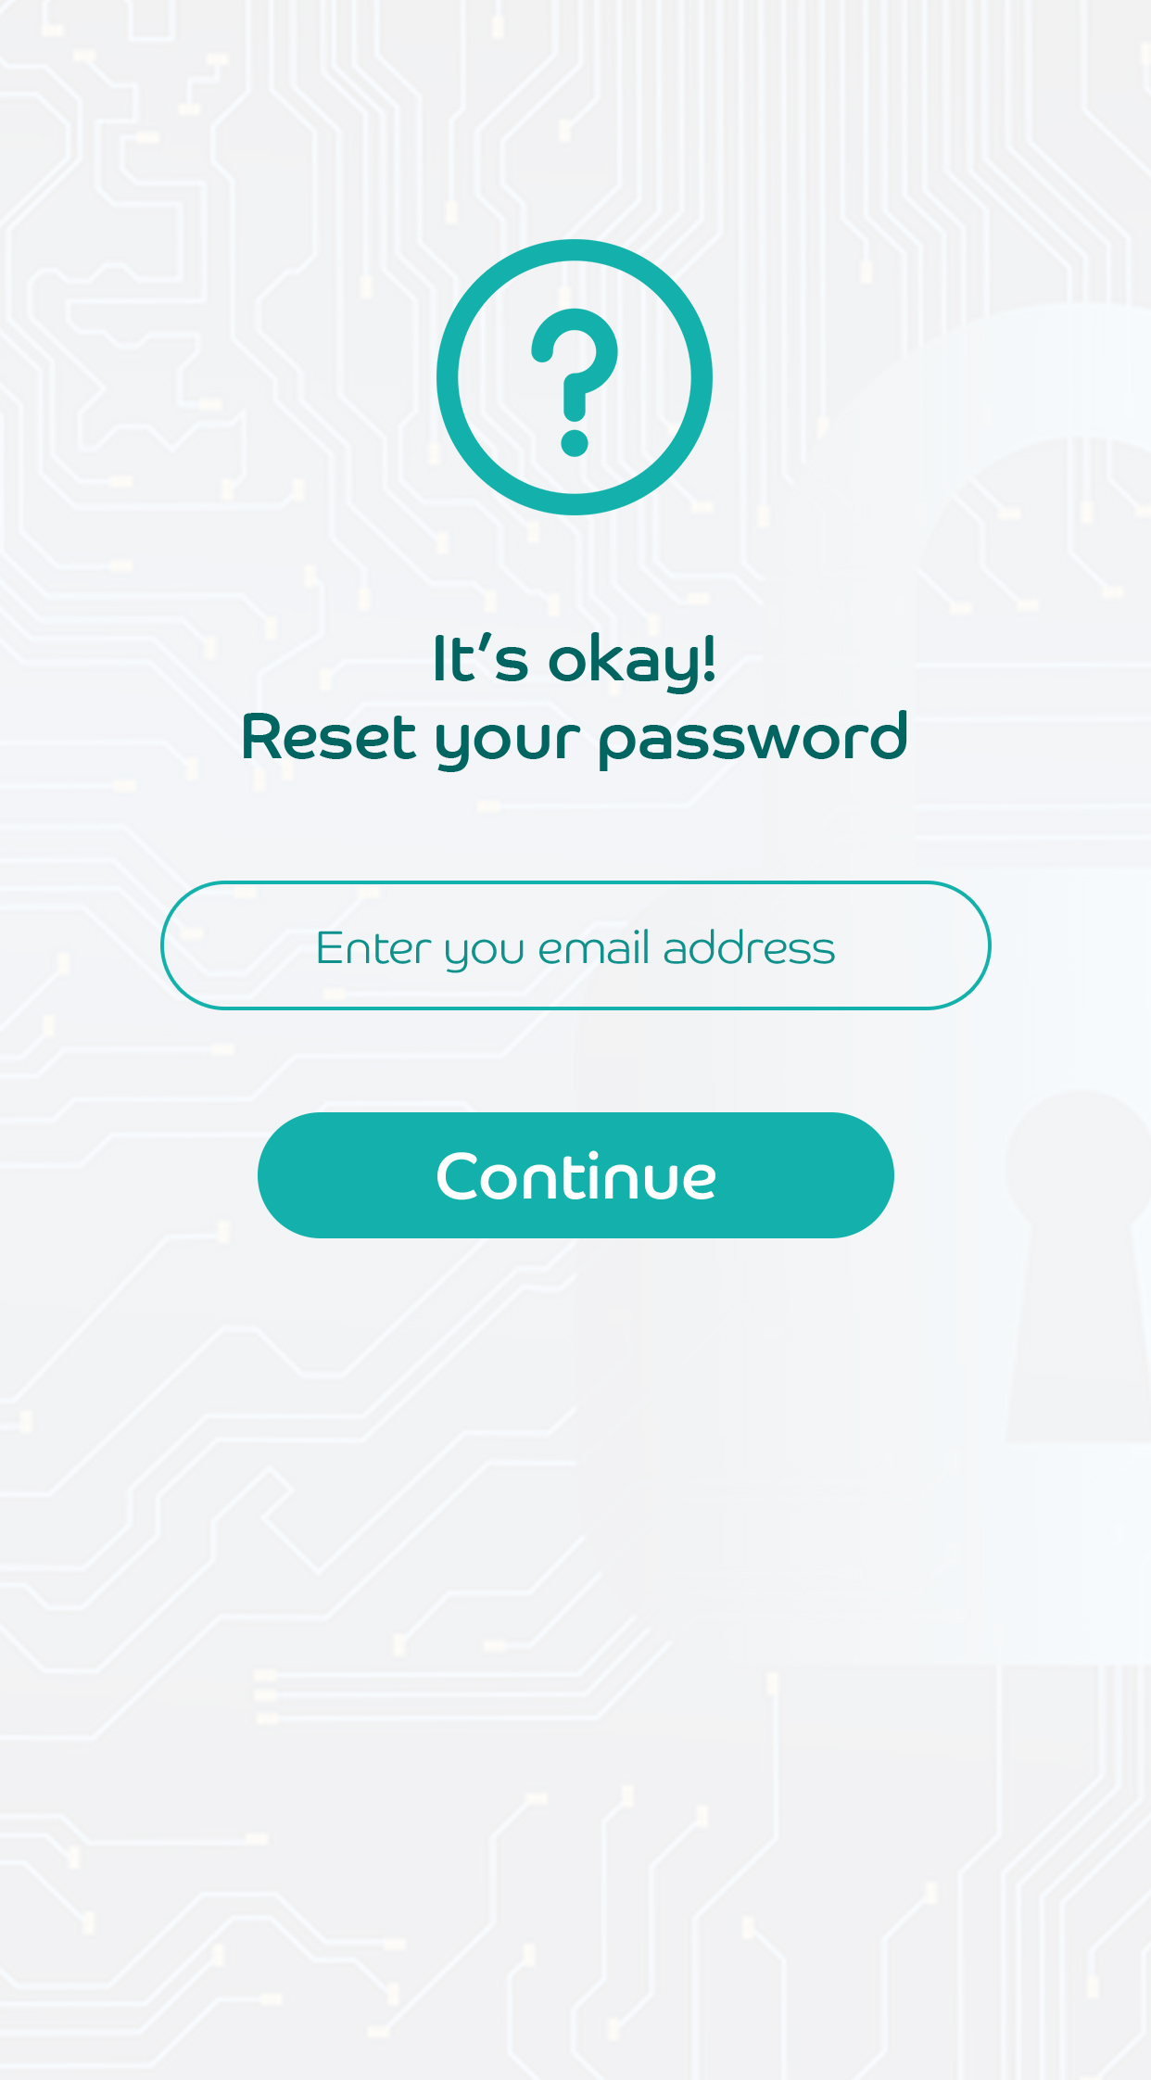
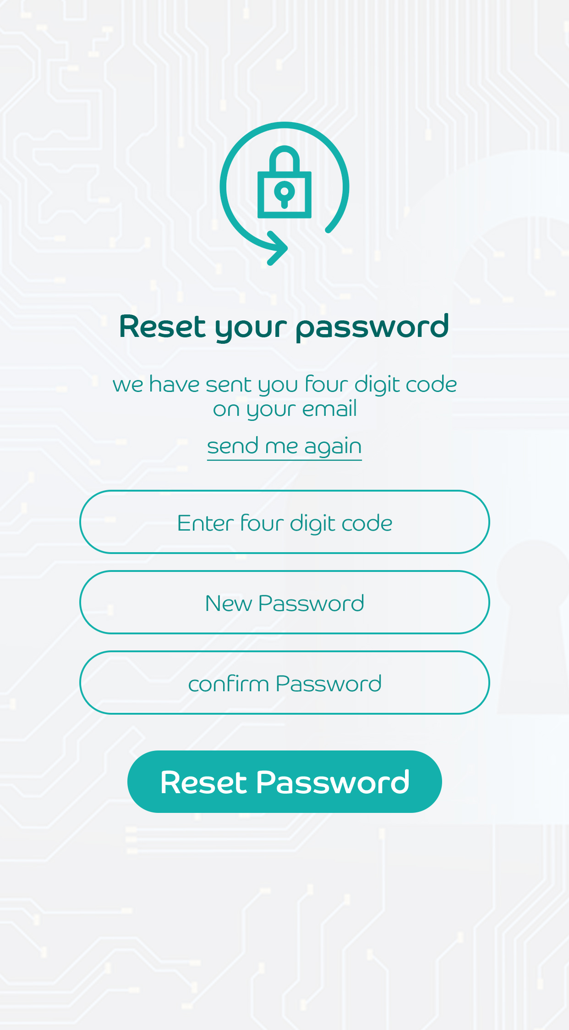
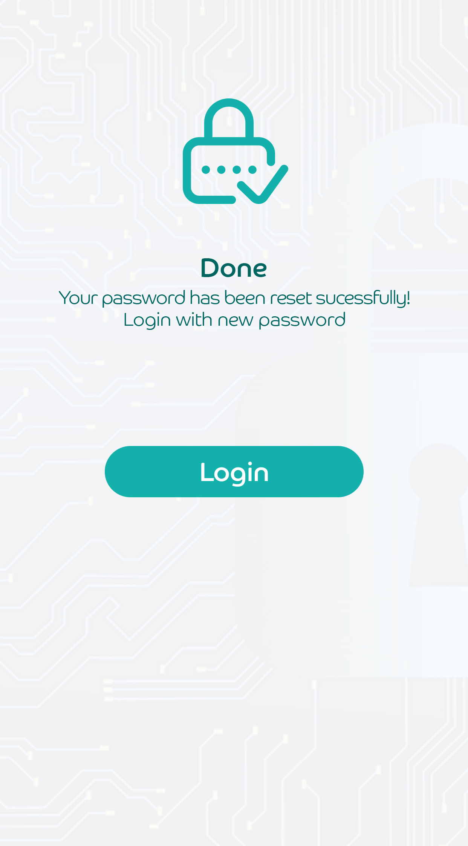
Forgot password

Slide 5
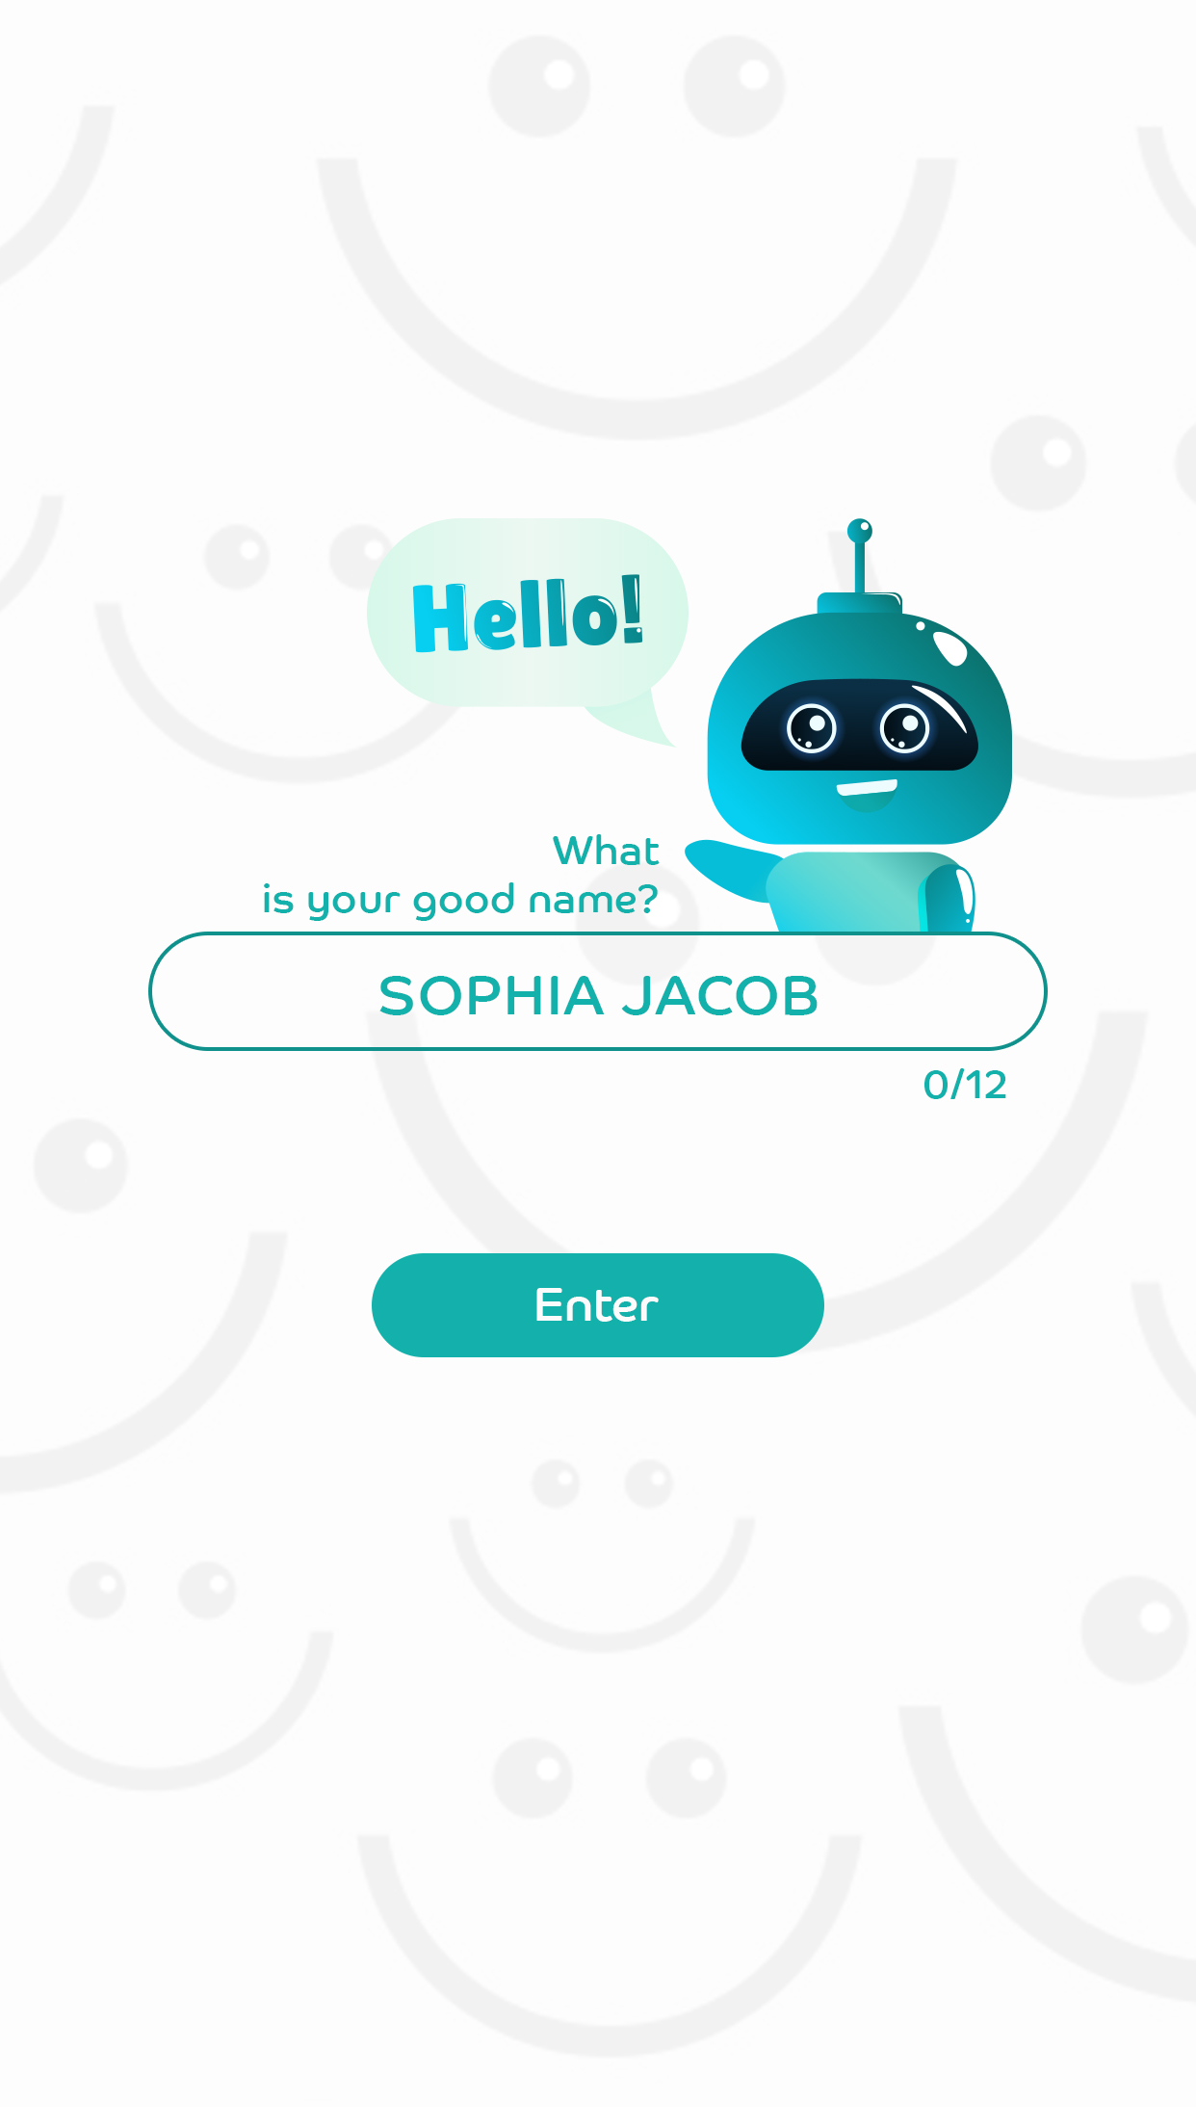
User module

Slide 6
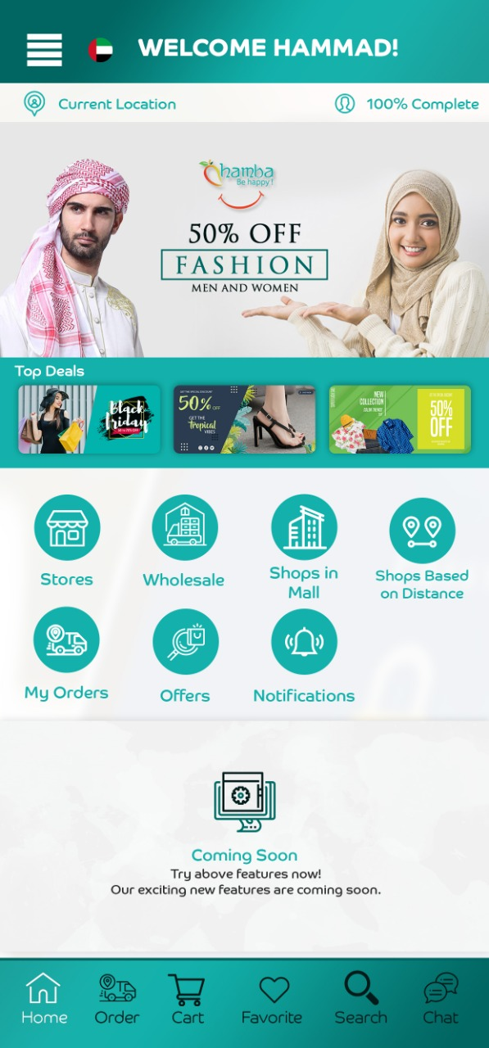
Dashboard

Slide 7
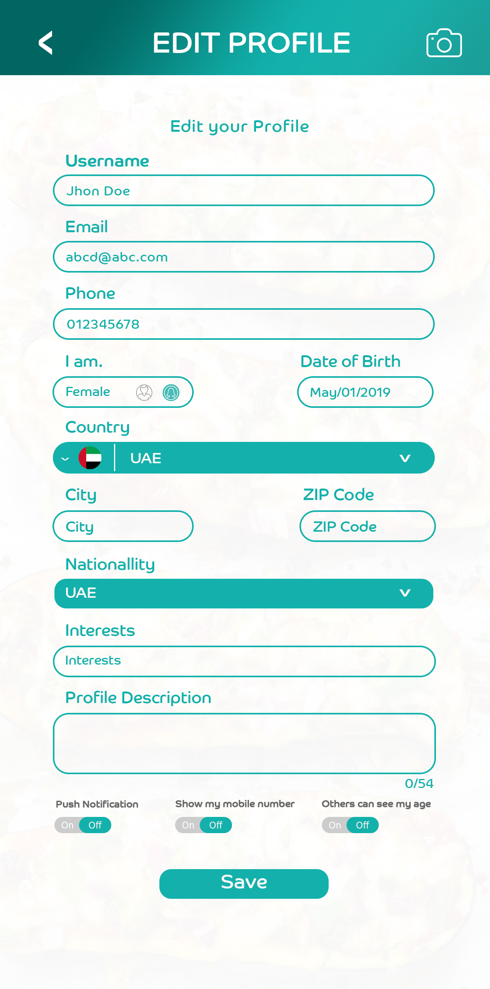
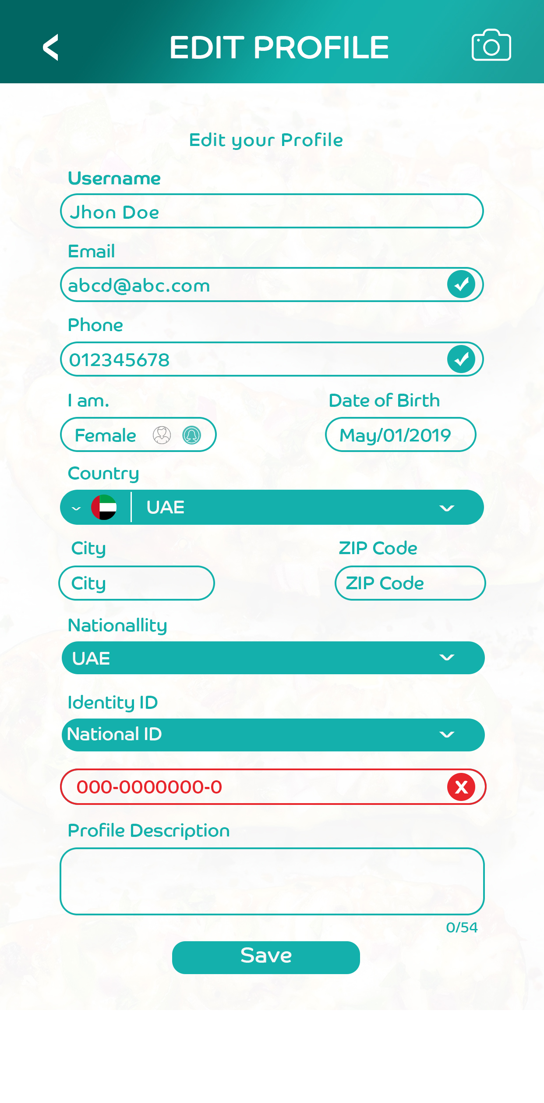
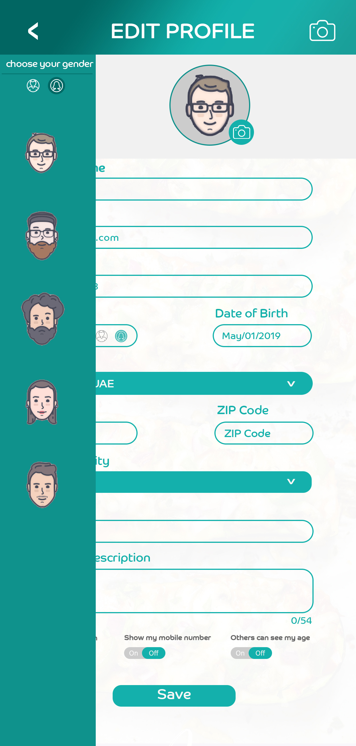
Edit Profile

Slide 8
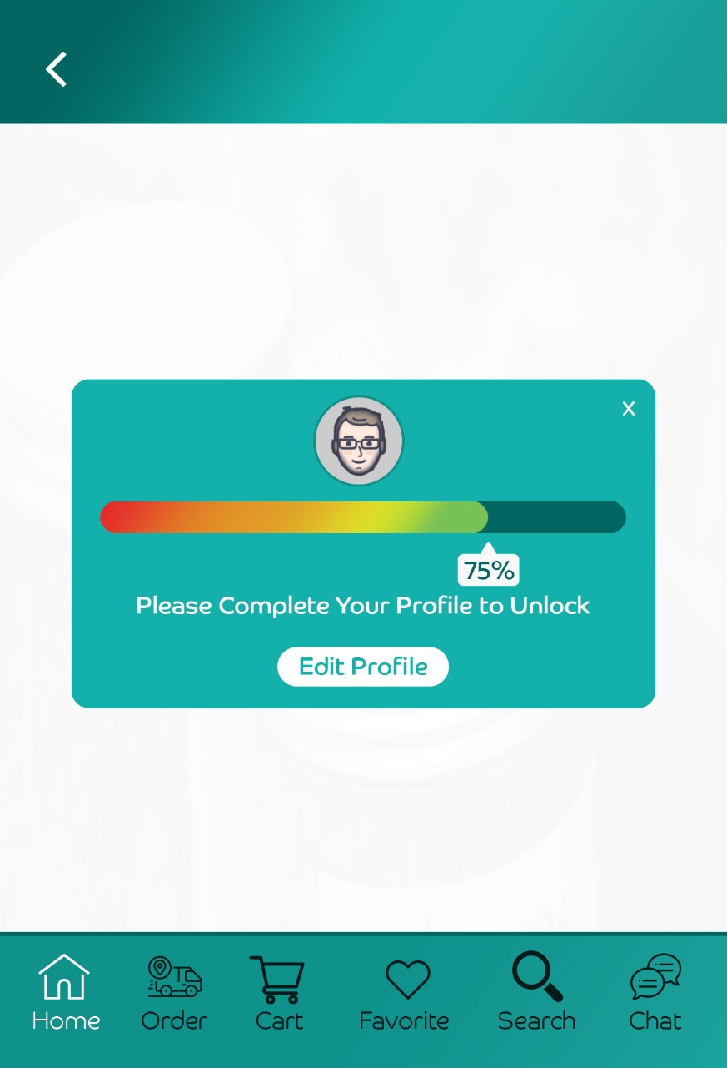
Profile Percentage

Slide 9
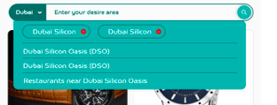
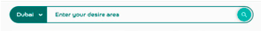
Main store , nearby, restaurants & grocery screen contain area search

Slide 10
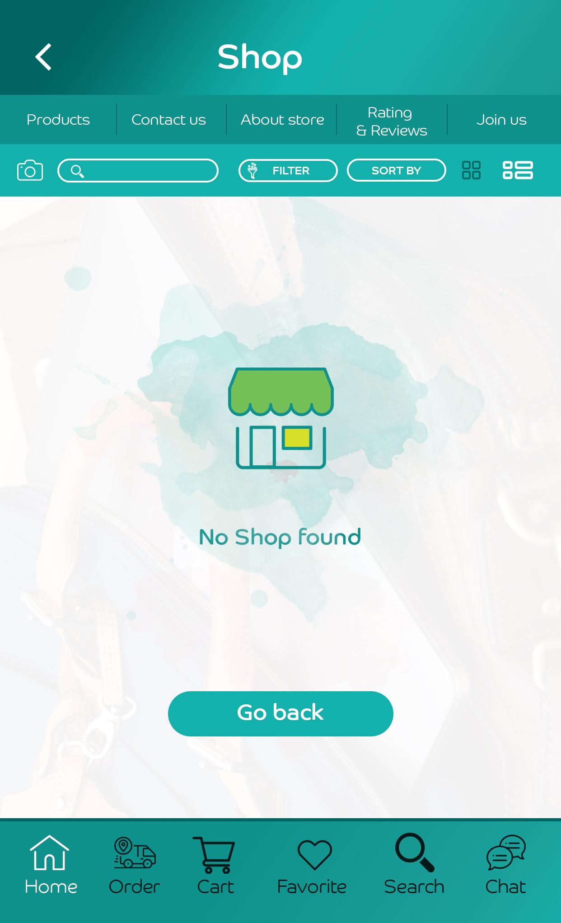
Stores
If there is no data then screen should have no store found with go back button that redirects on home
Icon should be same as new icon.

Slide 11
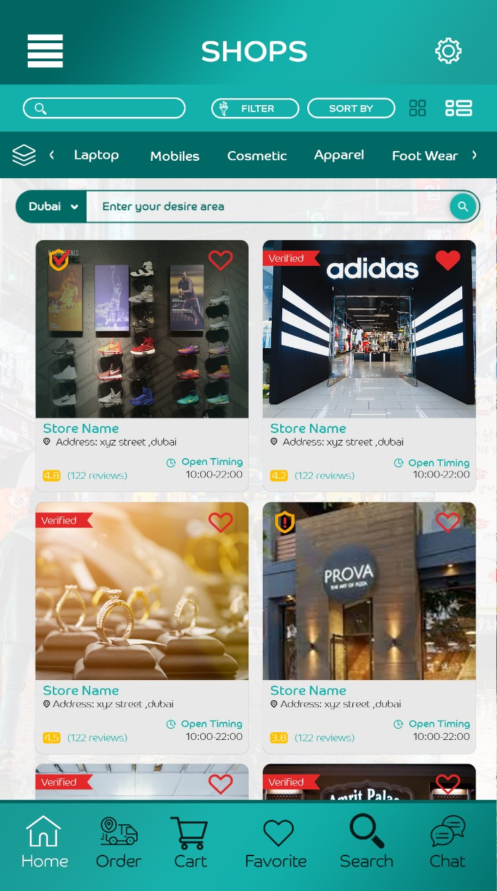
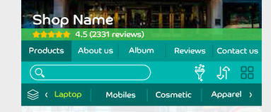
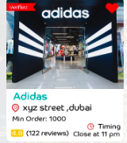
Stores
Only keeping grid view no list view
Search should work with proper functionality
Filter & sort only icons as per new design
Side menu(icon) should show all categories
Area search 1- Dubai drop should have all uae states
2-Enter your desire area should have all zones and zones will show on typing .
User can select multiple areas
Heart – favorite, unfavorite
Verified tags
Image should be in scale position (not stretched)

Slide 12
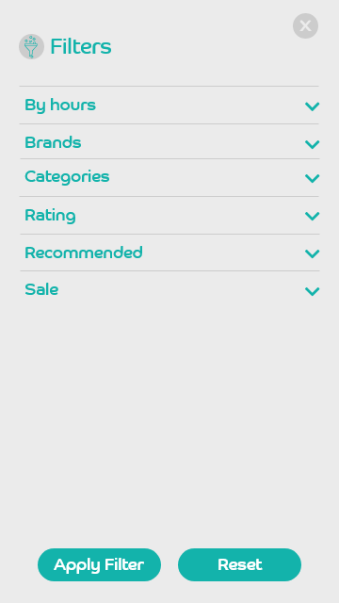
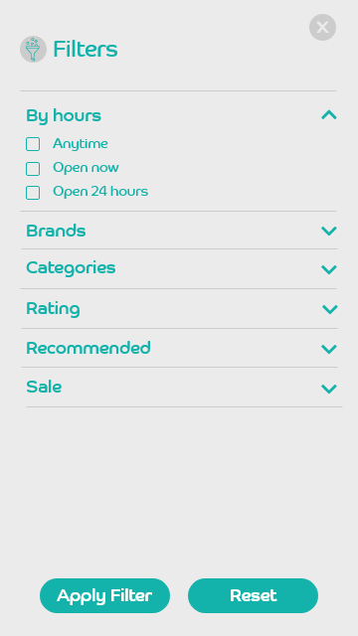
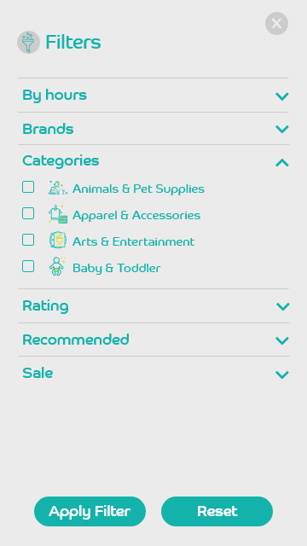
Filters
Filters icon should remove.
All filters should be as per discussion.
Only write apply

Slide 13
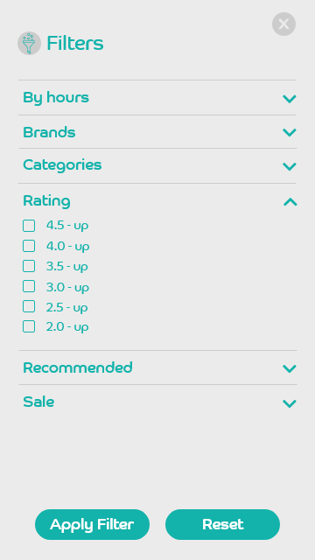
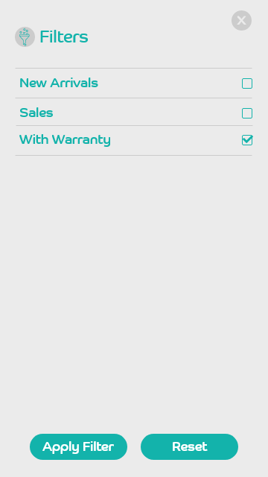
Filters
Only write apply

Slide 14
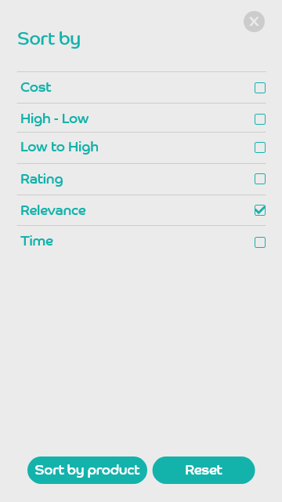
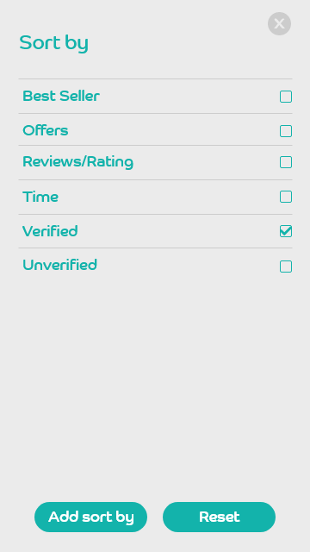
Stores

Slide 15
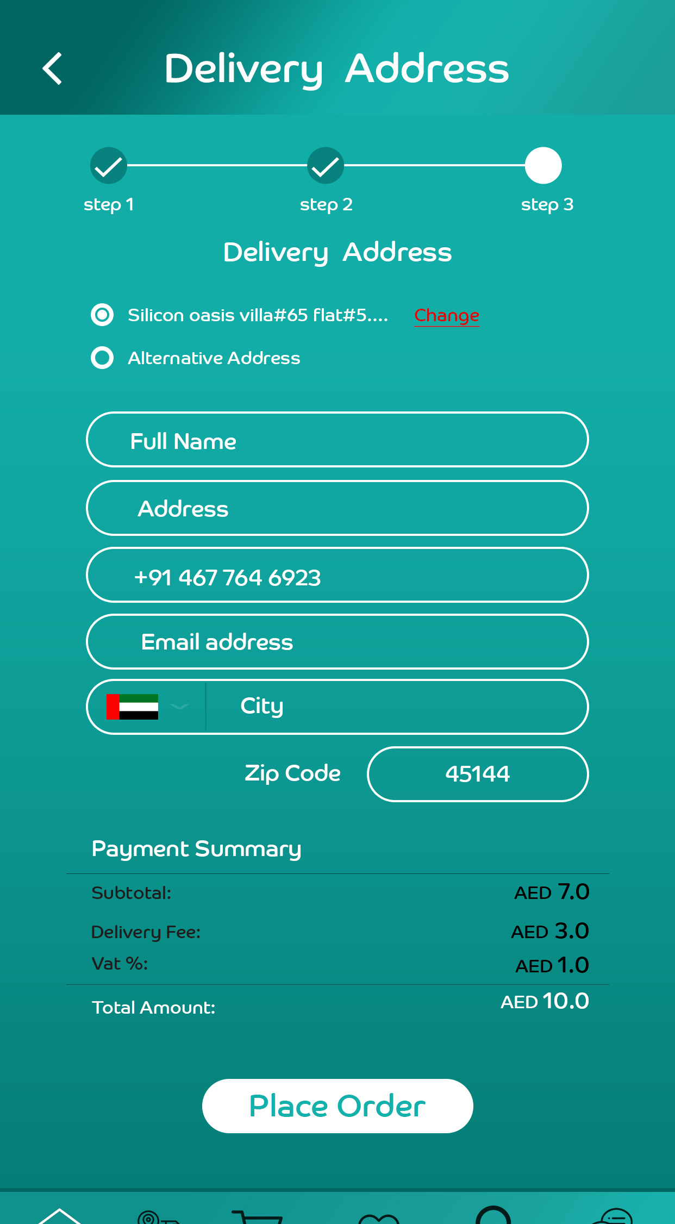
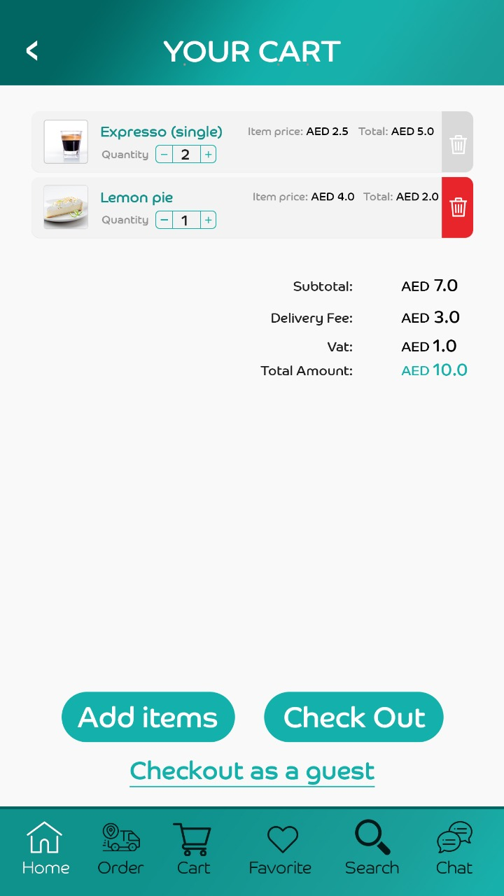
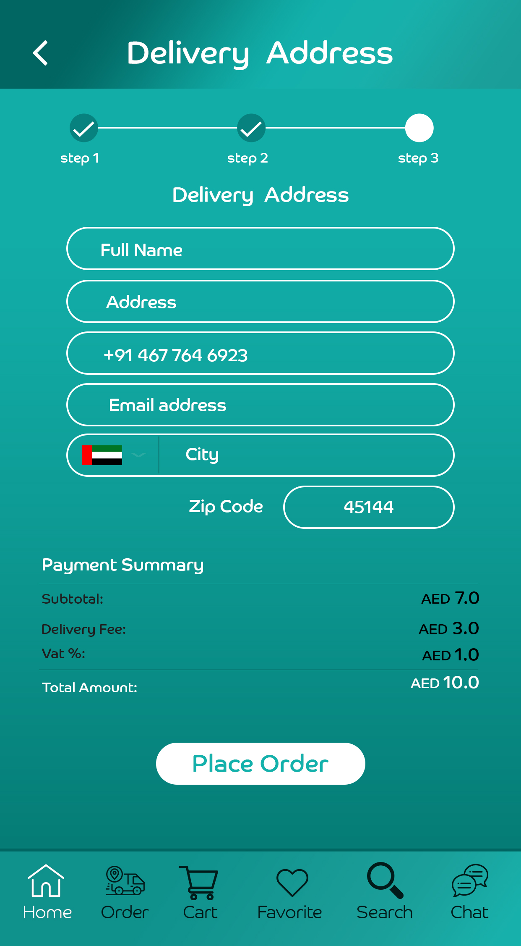
Without background image. Follow those colors and remove images . We will only keep images for user module till dashboard.

Slide 16
Sequence of store details bar and background opacity for store title and rating and reviews and shelves selection.

Slide 17
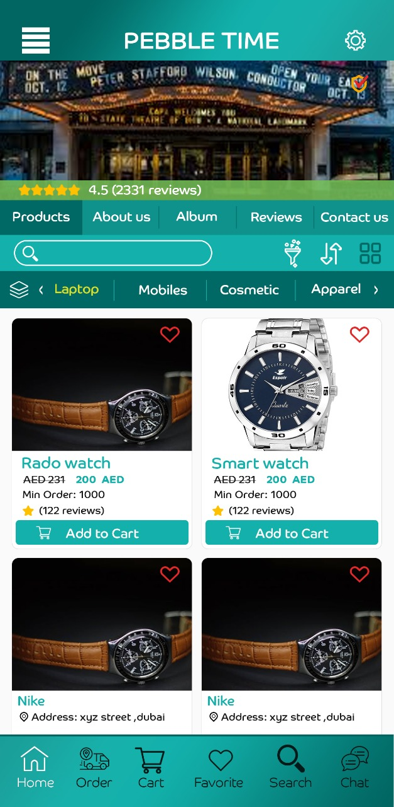
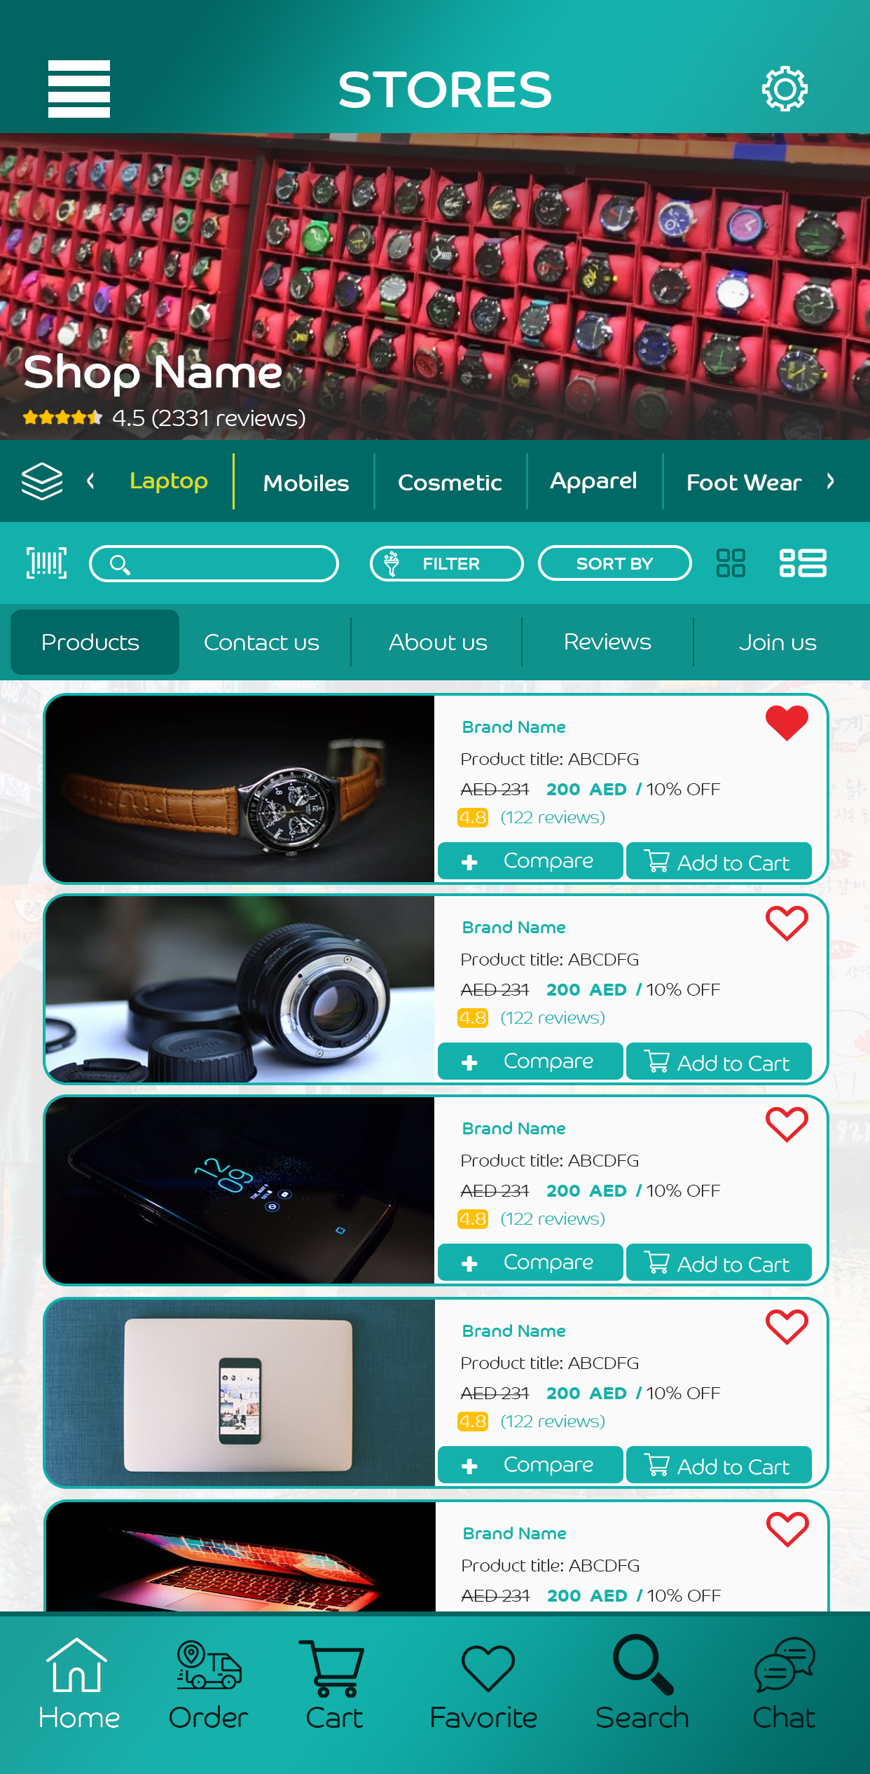
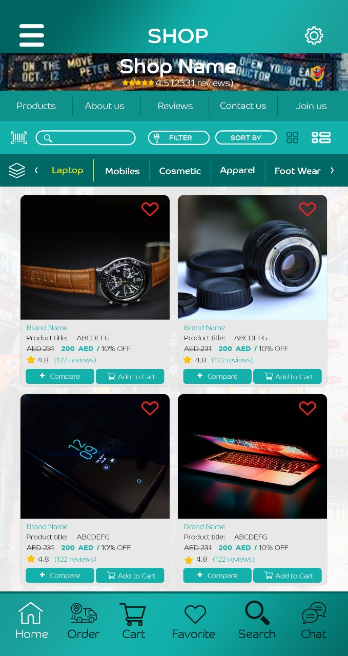
Stores / Shops Views
On scroll – banner option

Slide 18
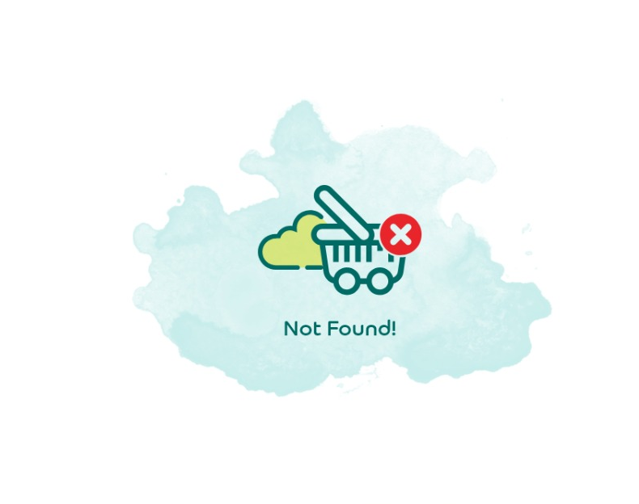
Not found for all

Slide 19
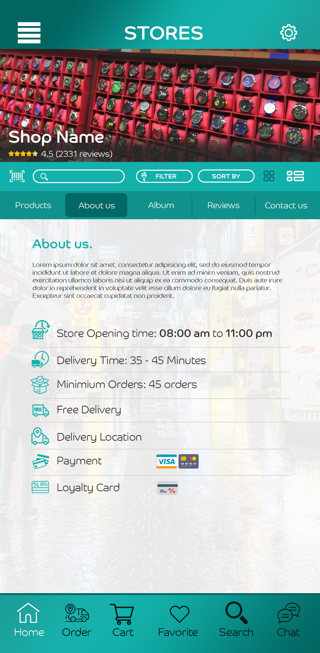
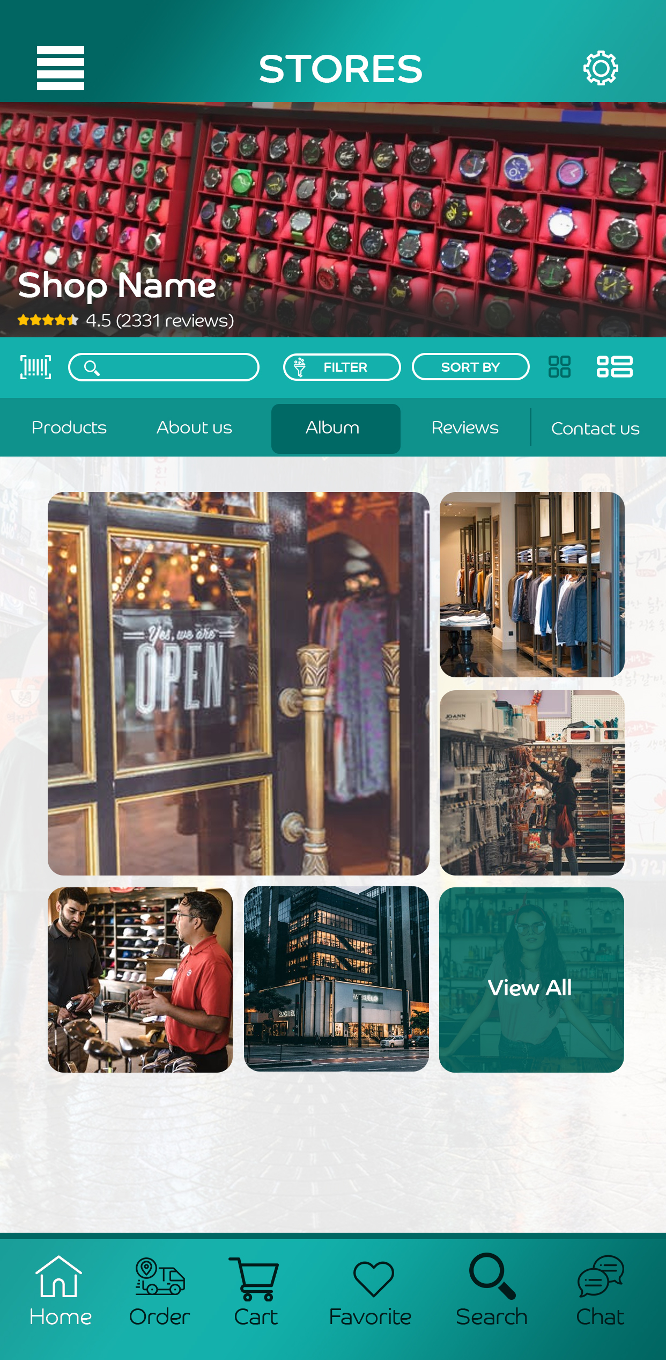
Store / Shops Detail Views
Make it one icon (list and grid)
Filter & sort only icons

Slide 20
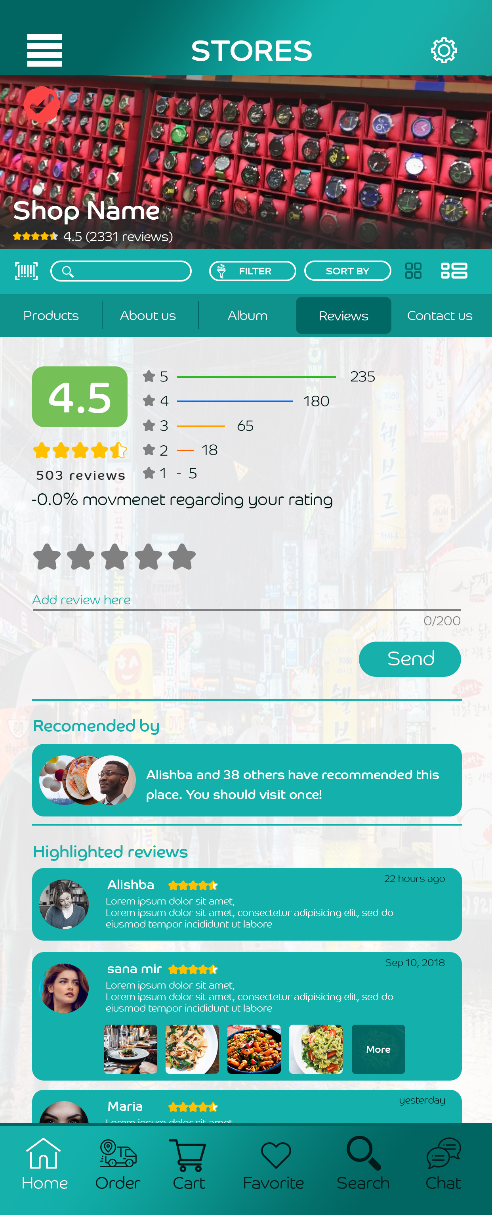
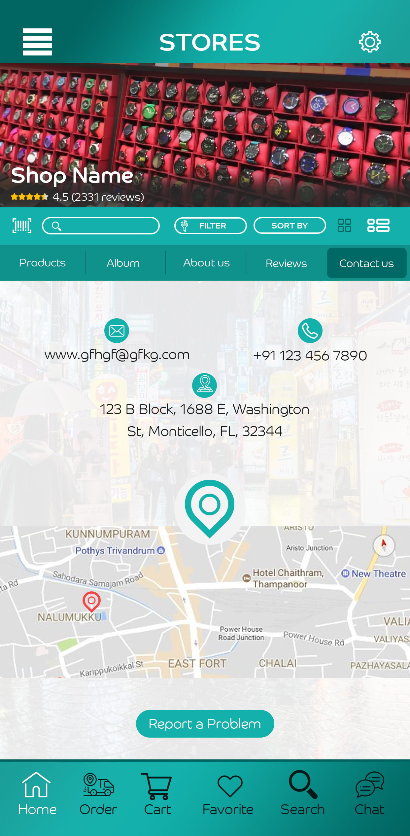
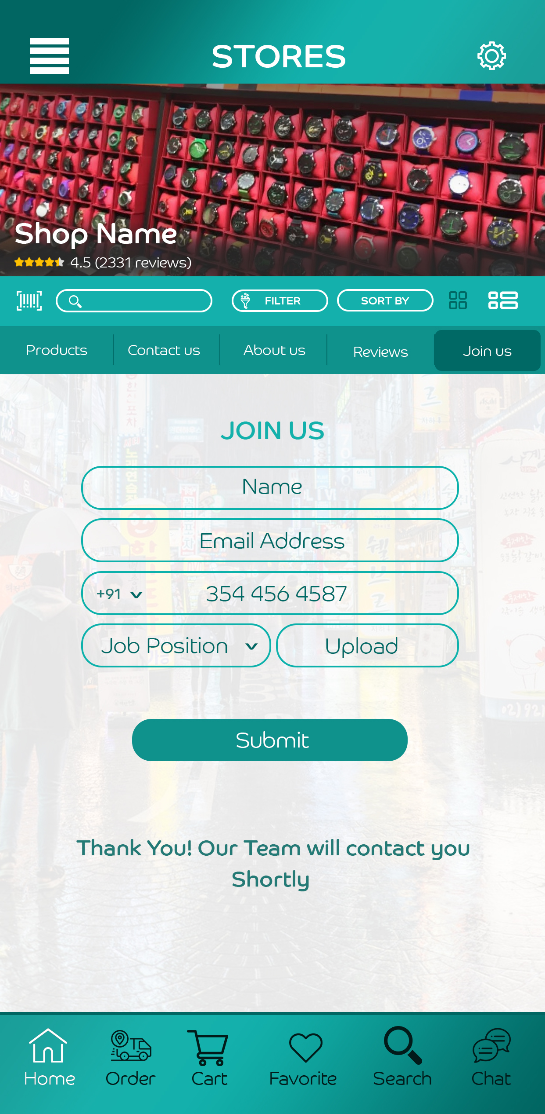
Shops / Store Detail View

Slide 21
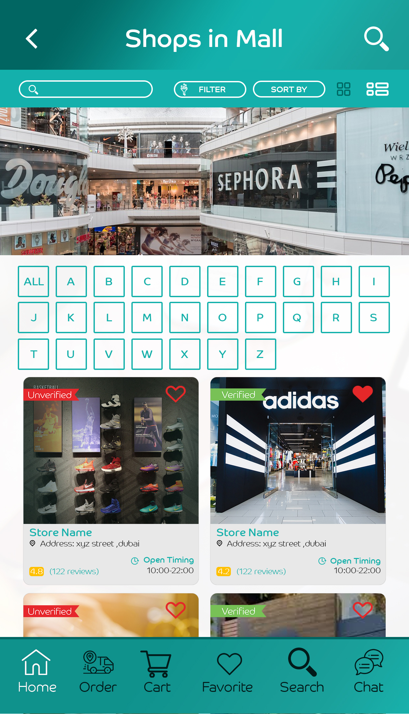
Shops in Mall

Slide 22
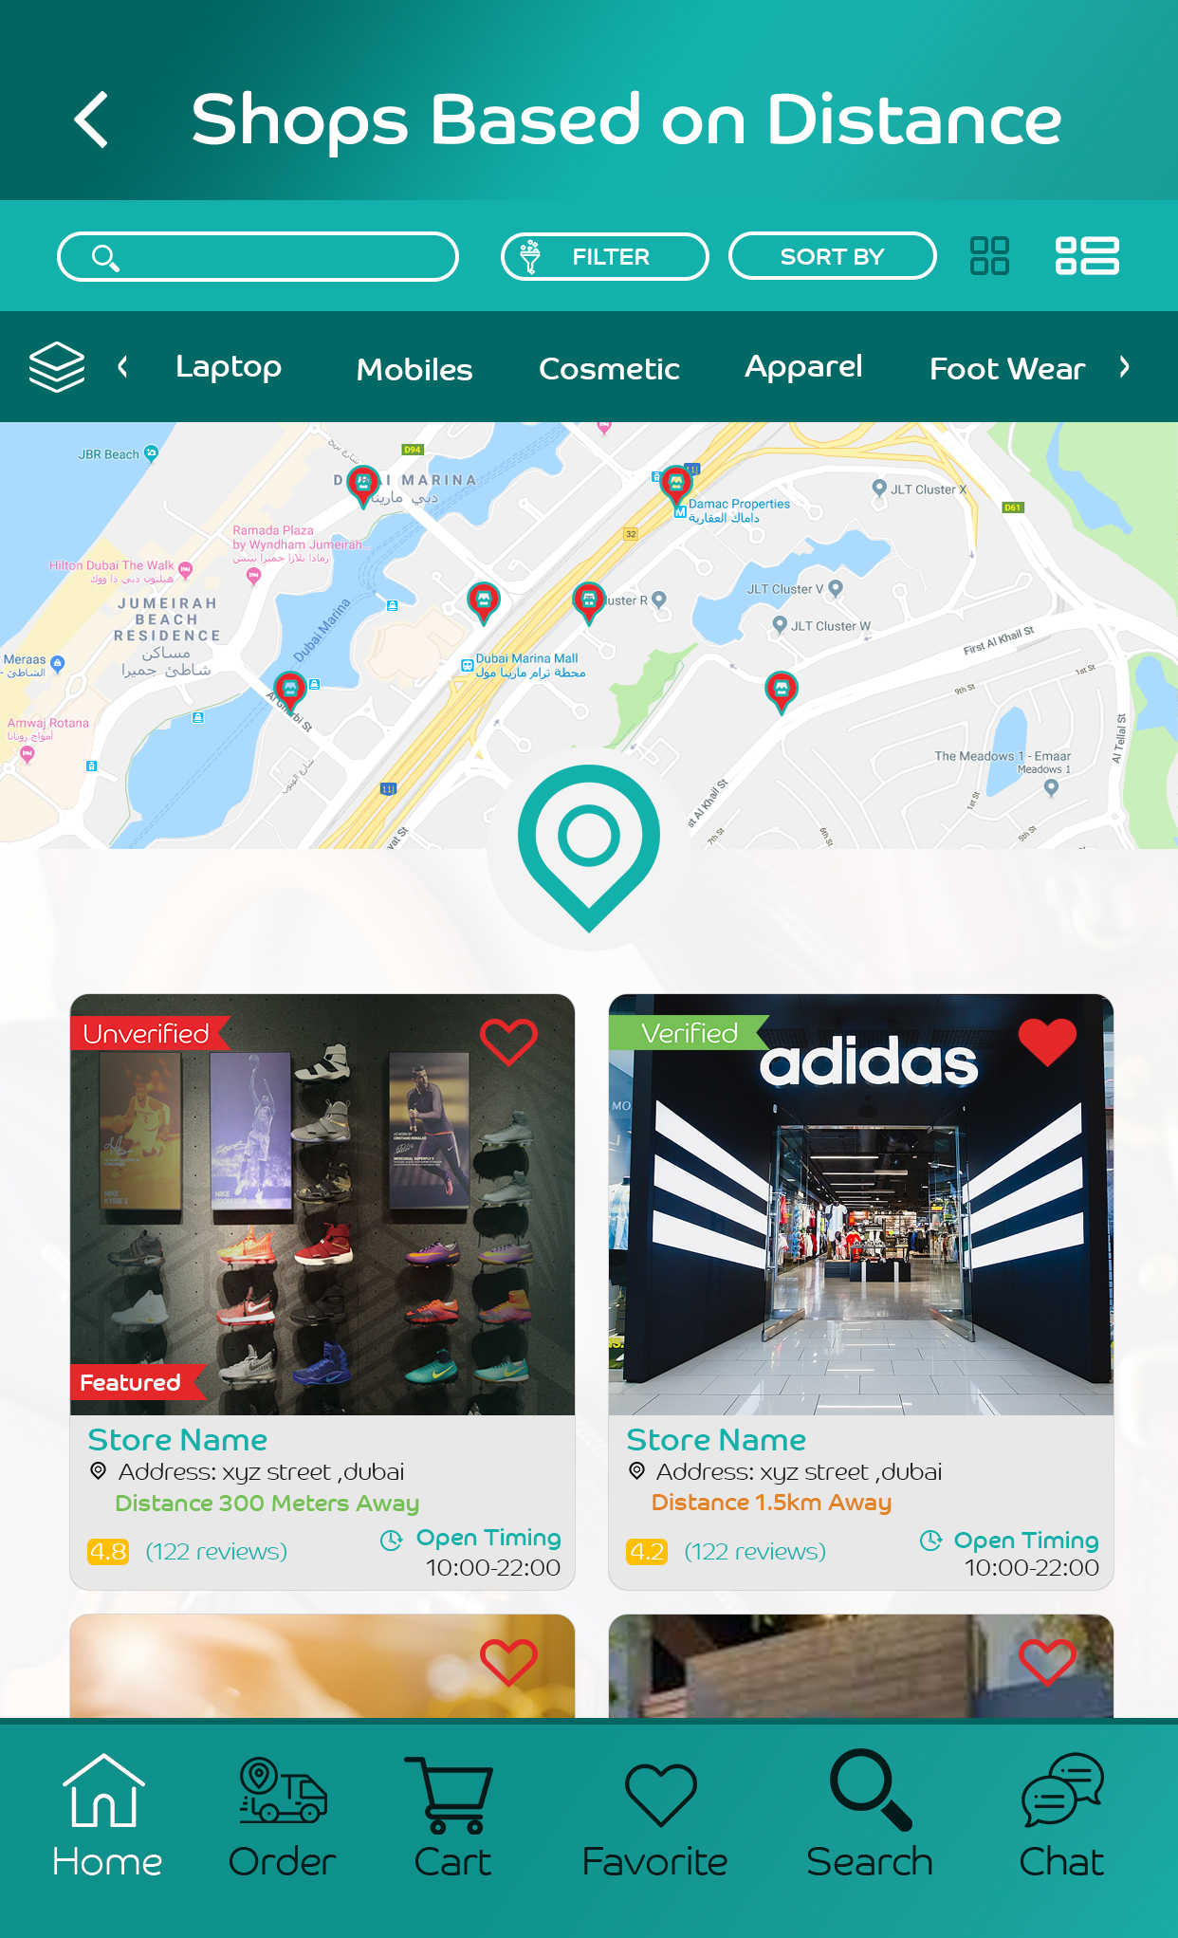
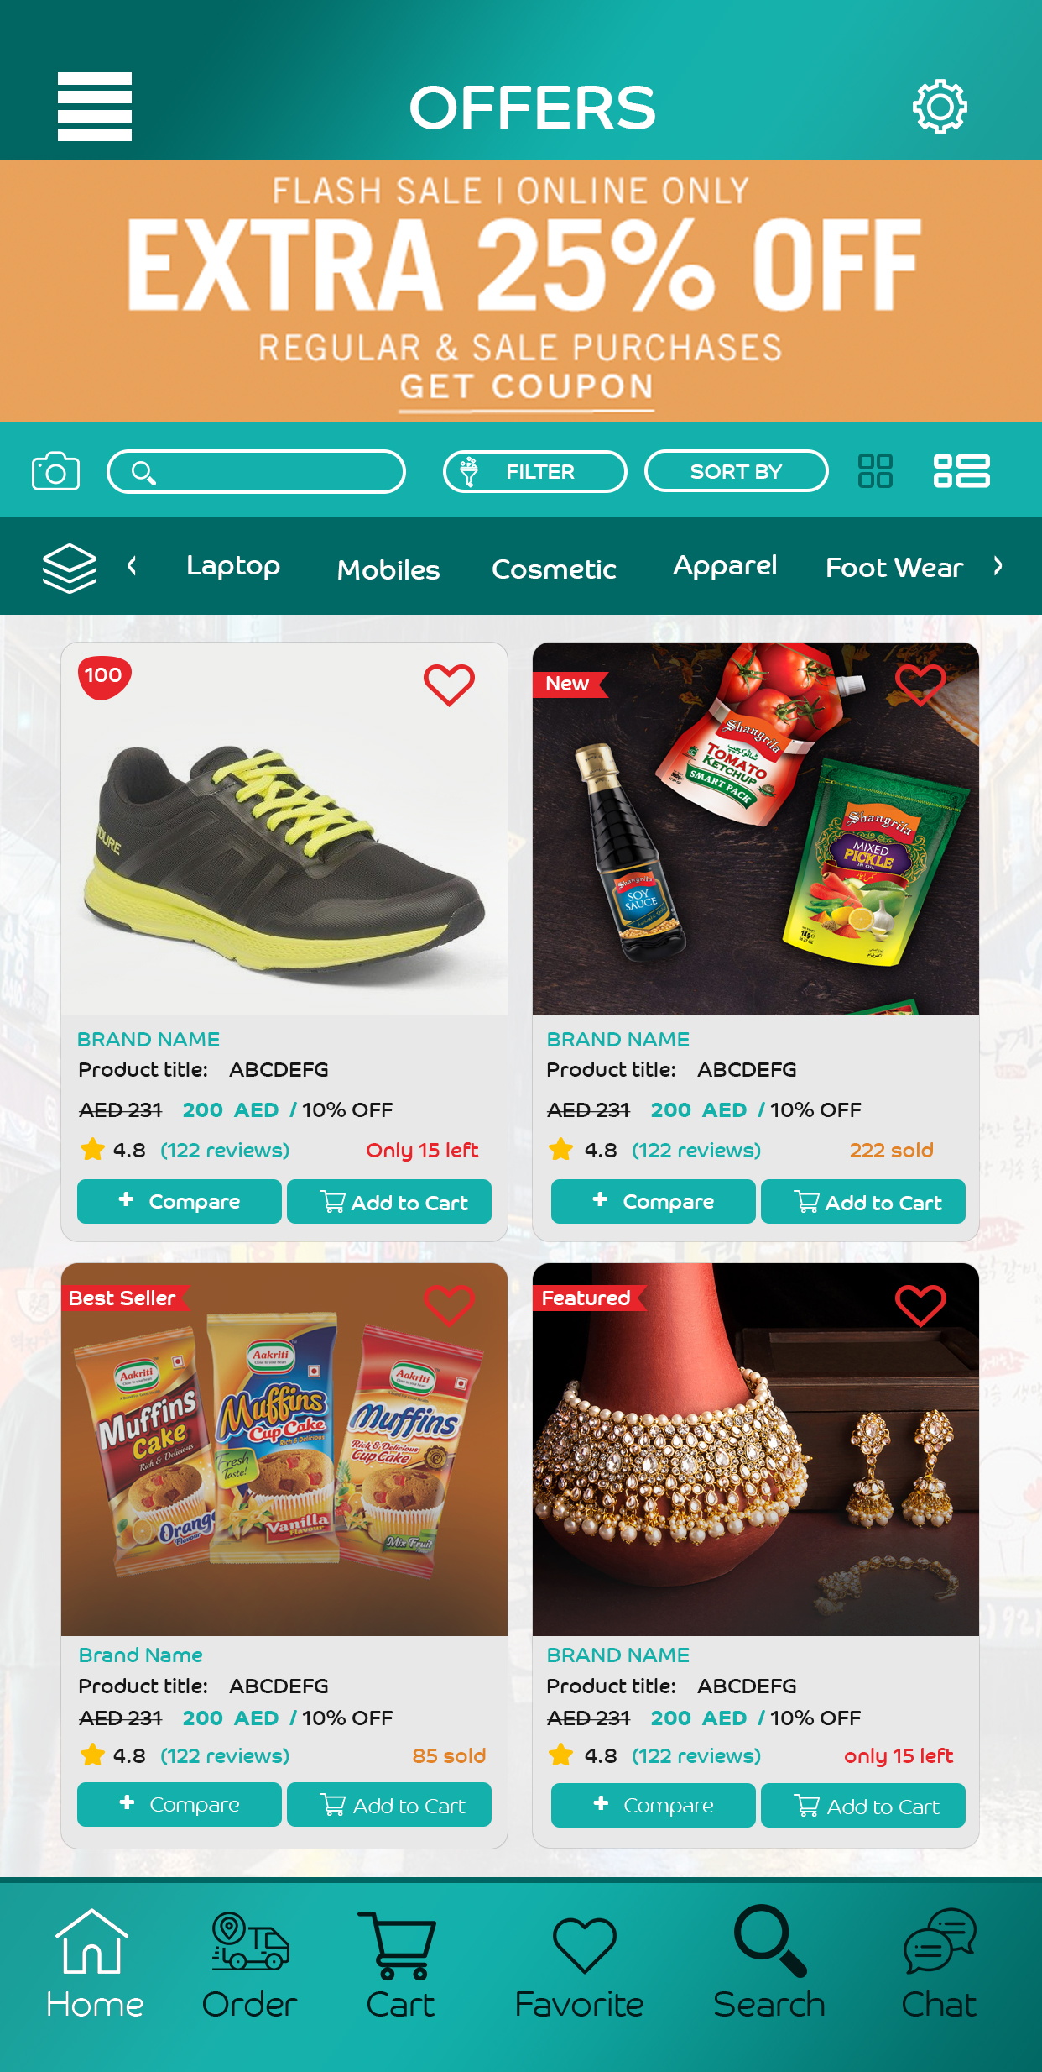
Nearby Shops
Offers/stores discount

Slide 23
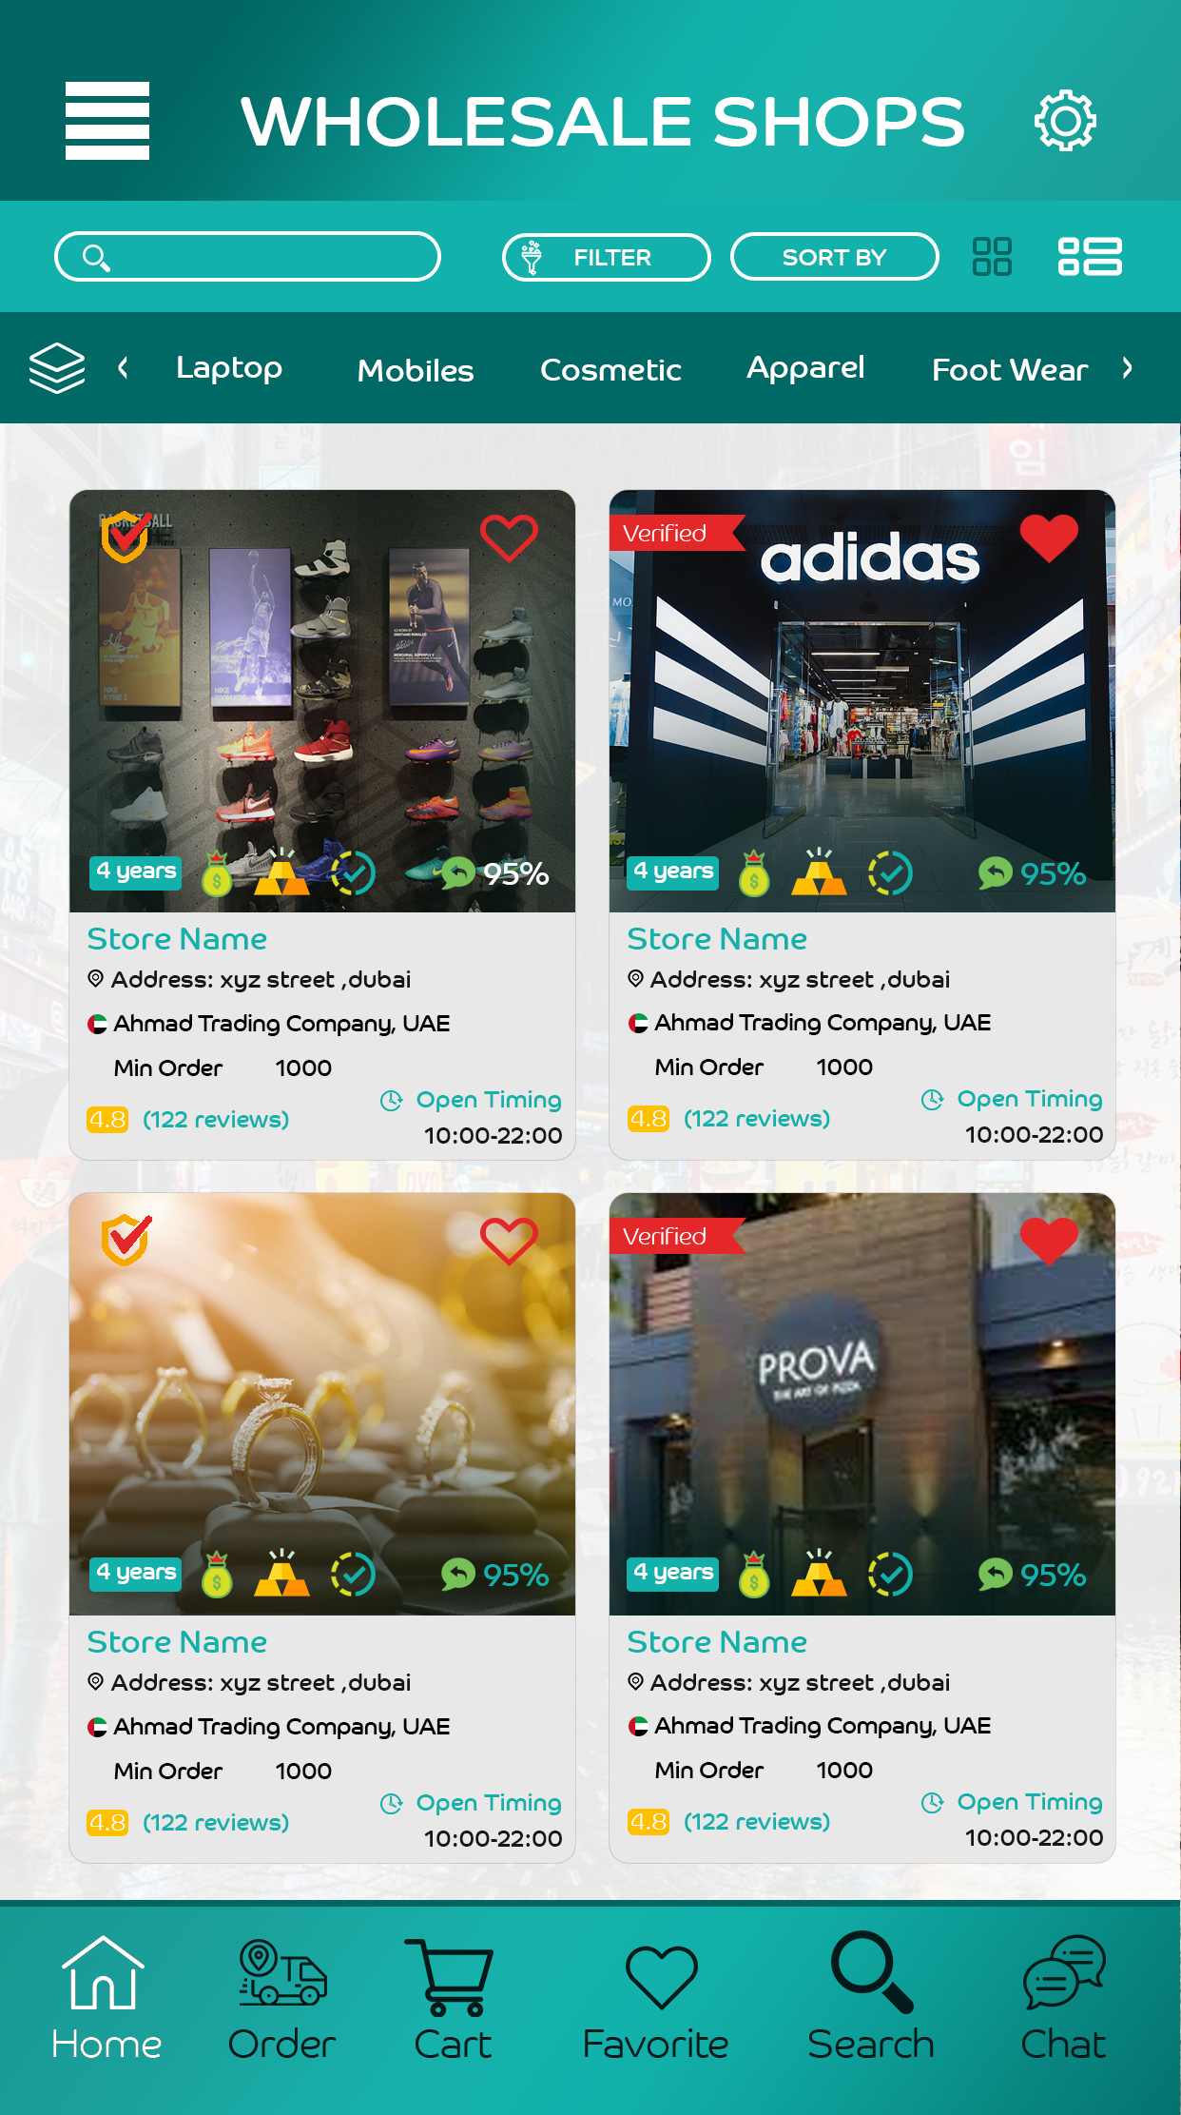
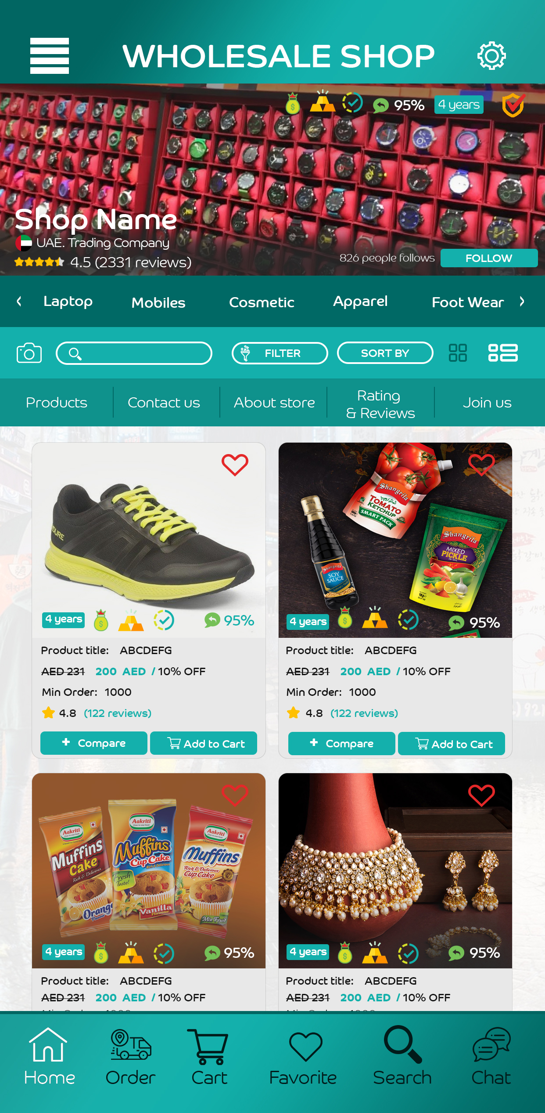
Wholesale

Slide 24
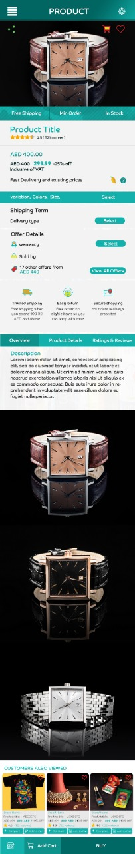
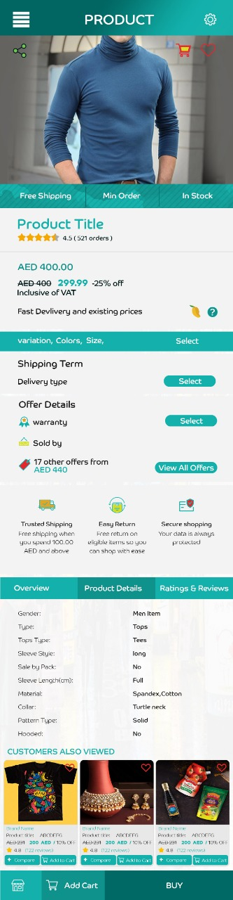
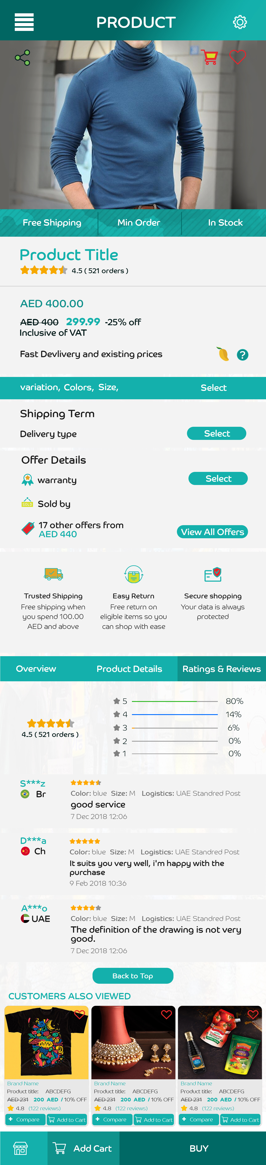
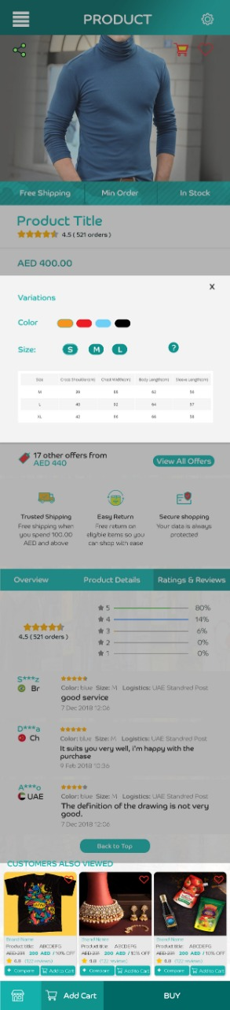
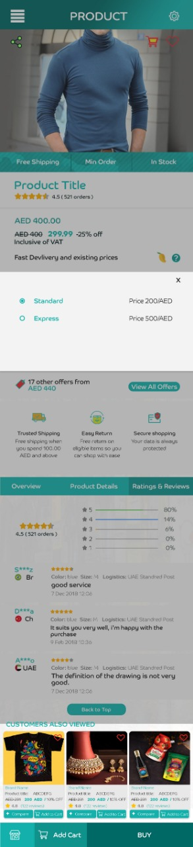
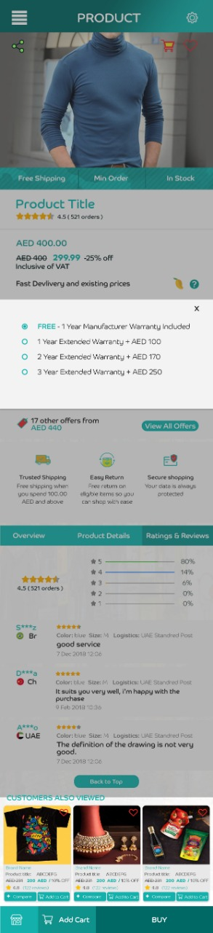
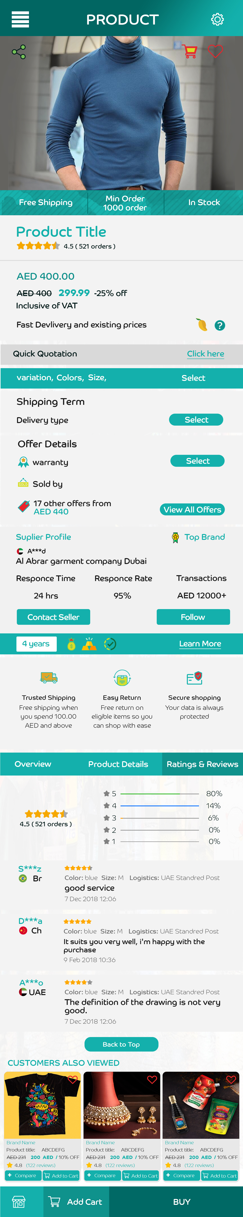
Product Details
Wholesale Product Details

Slide 25
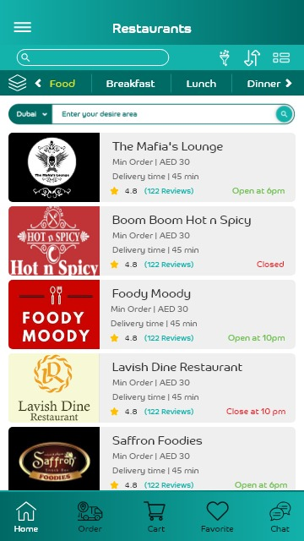


Restaurants

Slide 26



Grocery Store
Same as previous design

Slide 27



Grocery Store

Slide 28

Cart
We will skip Single basket delivery in baby launch – because it’s connecting with Professional, Services and My Work.

Slide 29

Checkout

Slide 30


CheckOut

Slide 31

Order summary / invoice
Total price

Slide 32



My Orders

Slide 33



Rate an order
Add reviews here same as store and it will show in products

Slide 34



Rate an order
Add reviews here same as store and it will show in products

Slide 35


Dispute Order

Slide 36



Manage address

Slide 37

Manage address

Slide 38



Notifications

Slide 39

Side Menu
Manage Address
Manage Account / profile
Special Offers
Your Orders
Support
With email and phone number
Rate us

